Slide 1
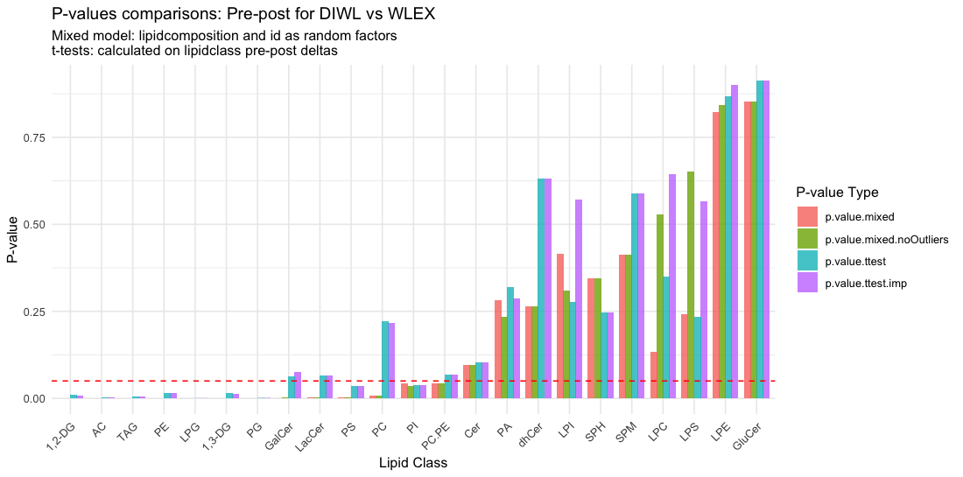
GalCer, LacCer, PC, and PC/PE are significant with mixed model but not t-tests

Slide 2
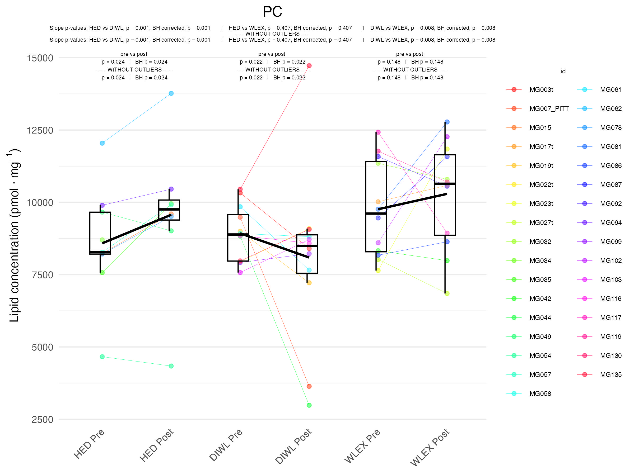
t-test: ~0.22
mixed model: ~ 0.01

Slide 3
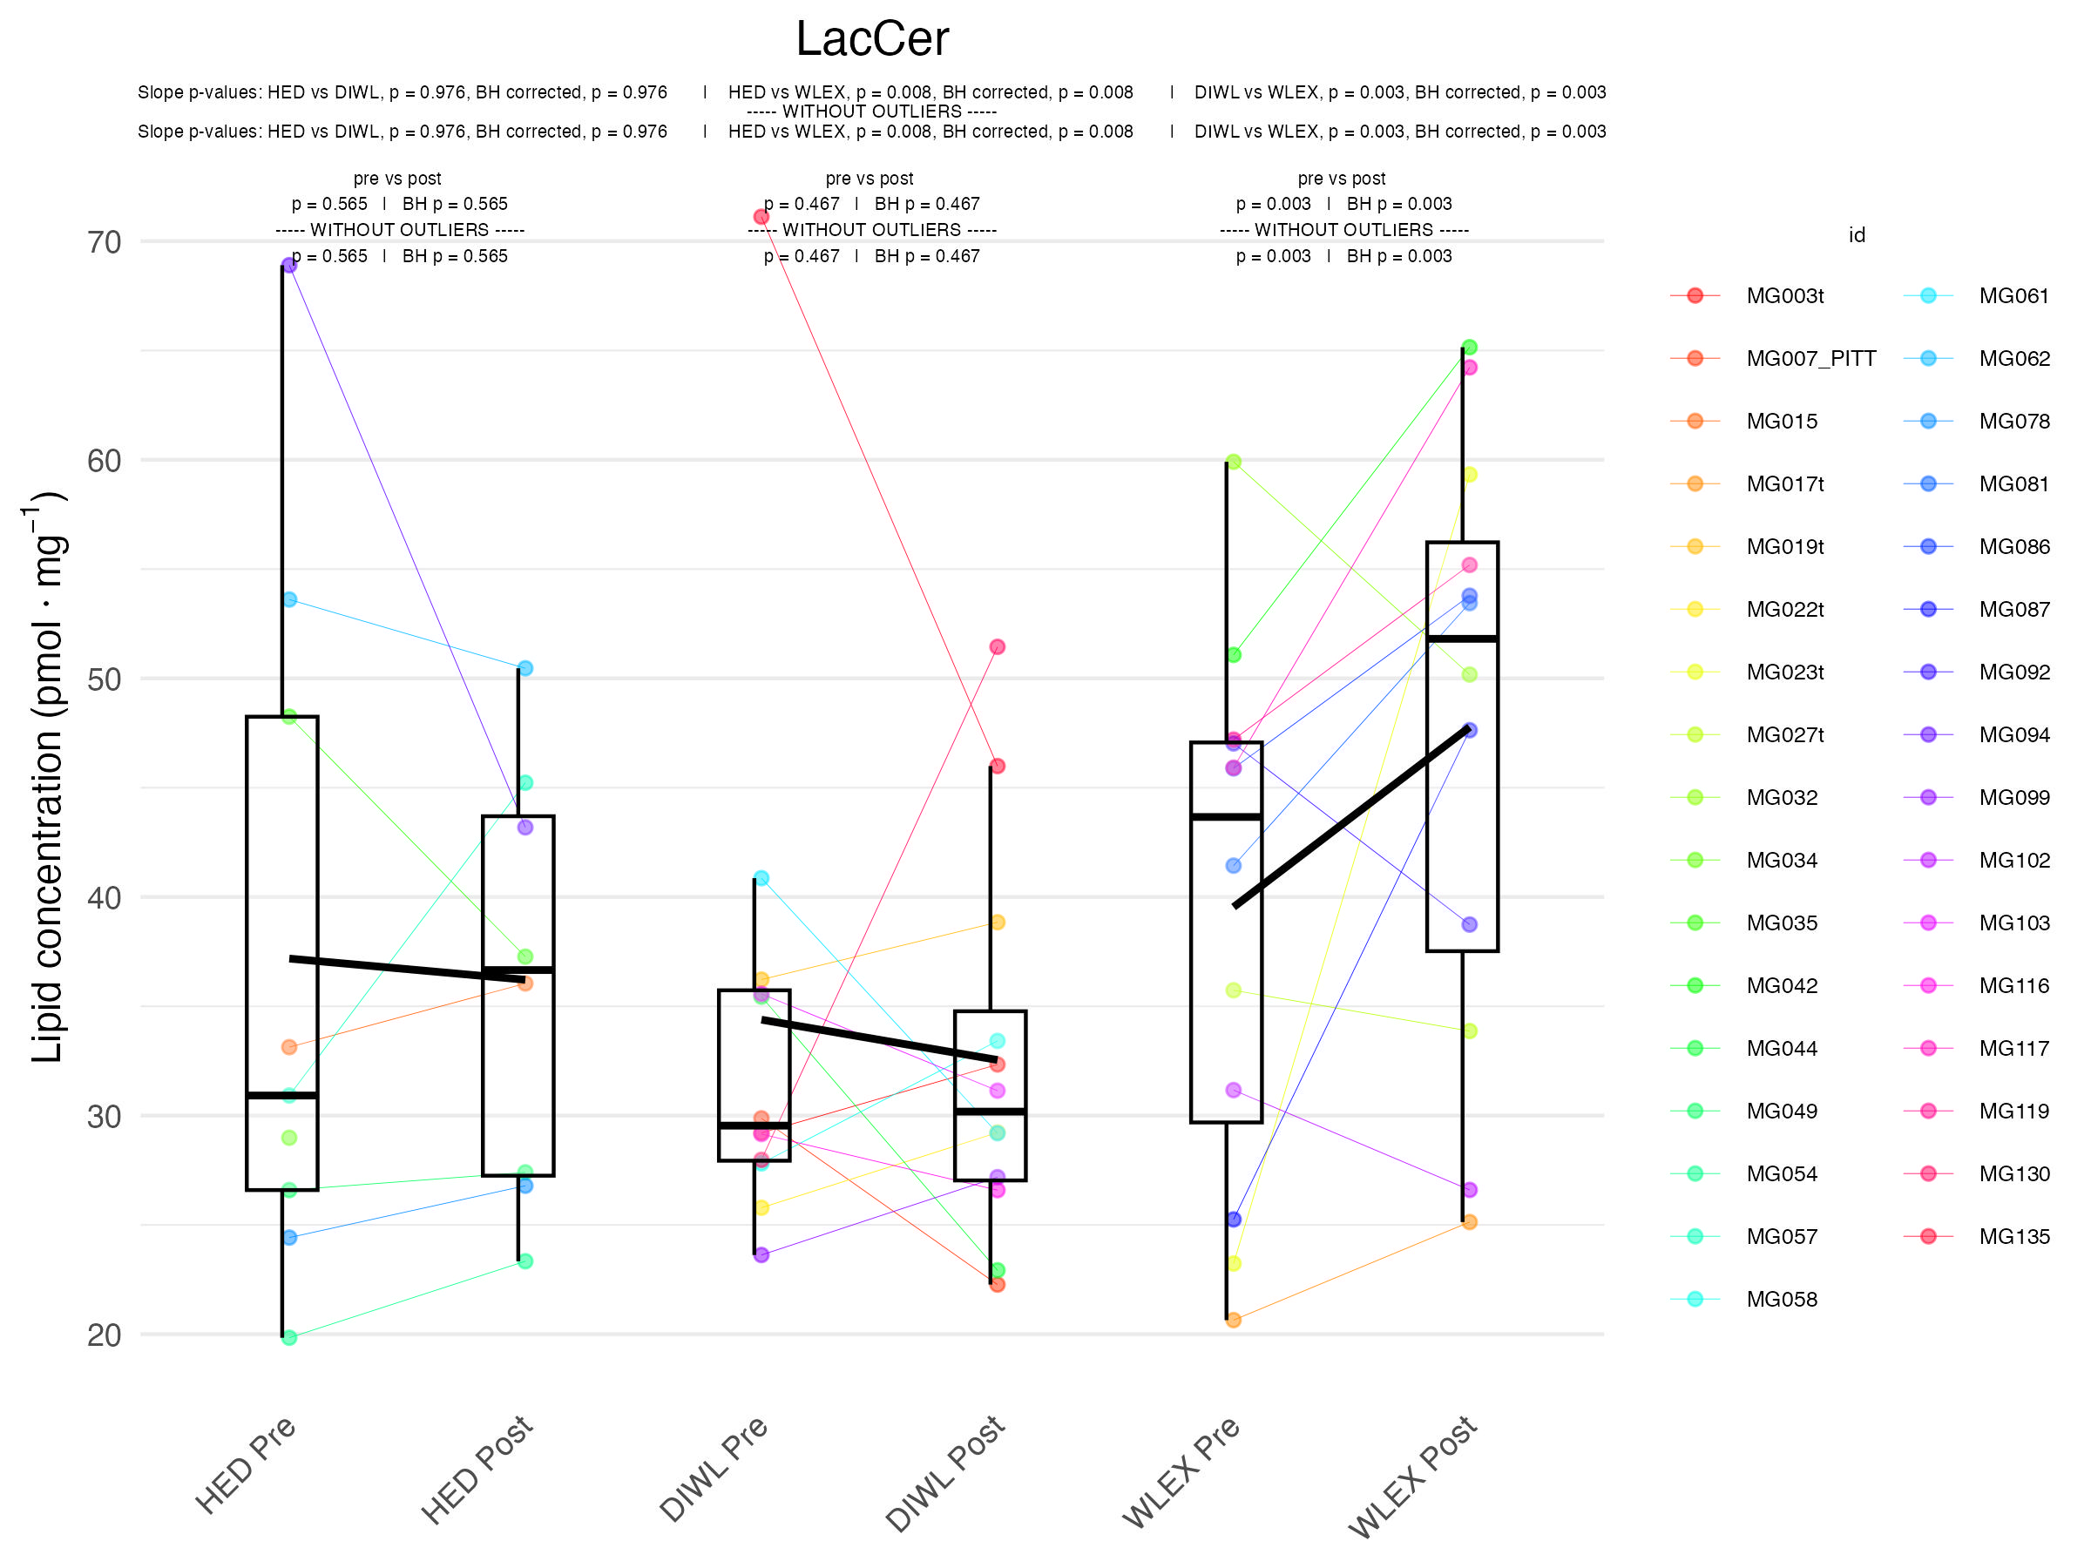
t-test: ~0.06
mixed model: ~ 0.03

Slide 4
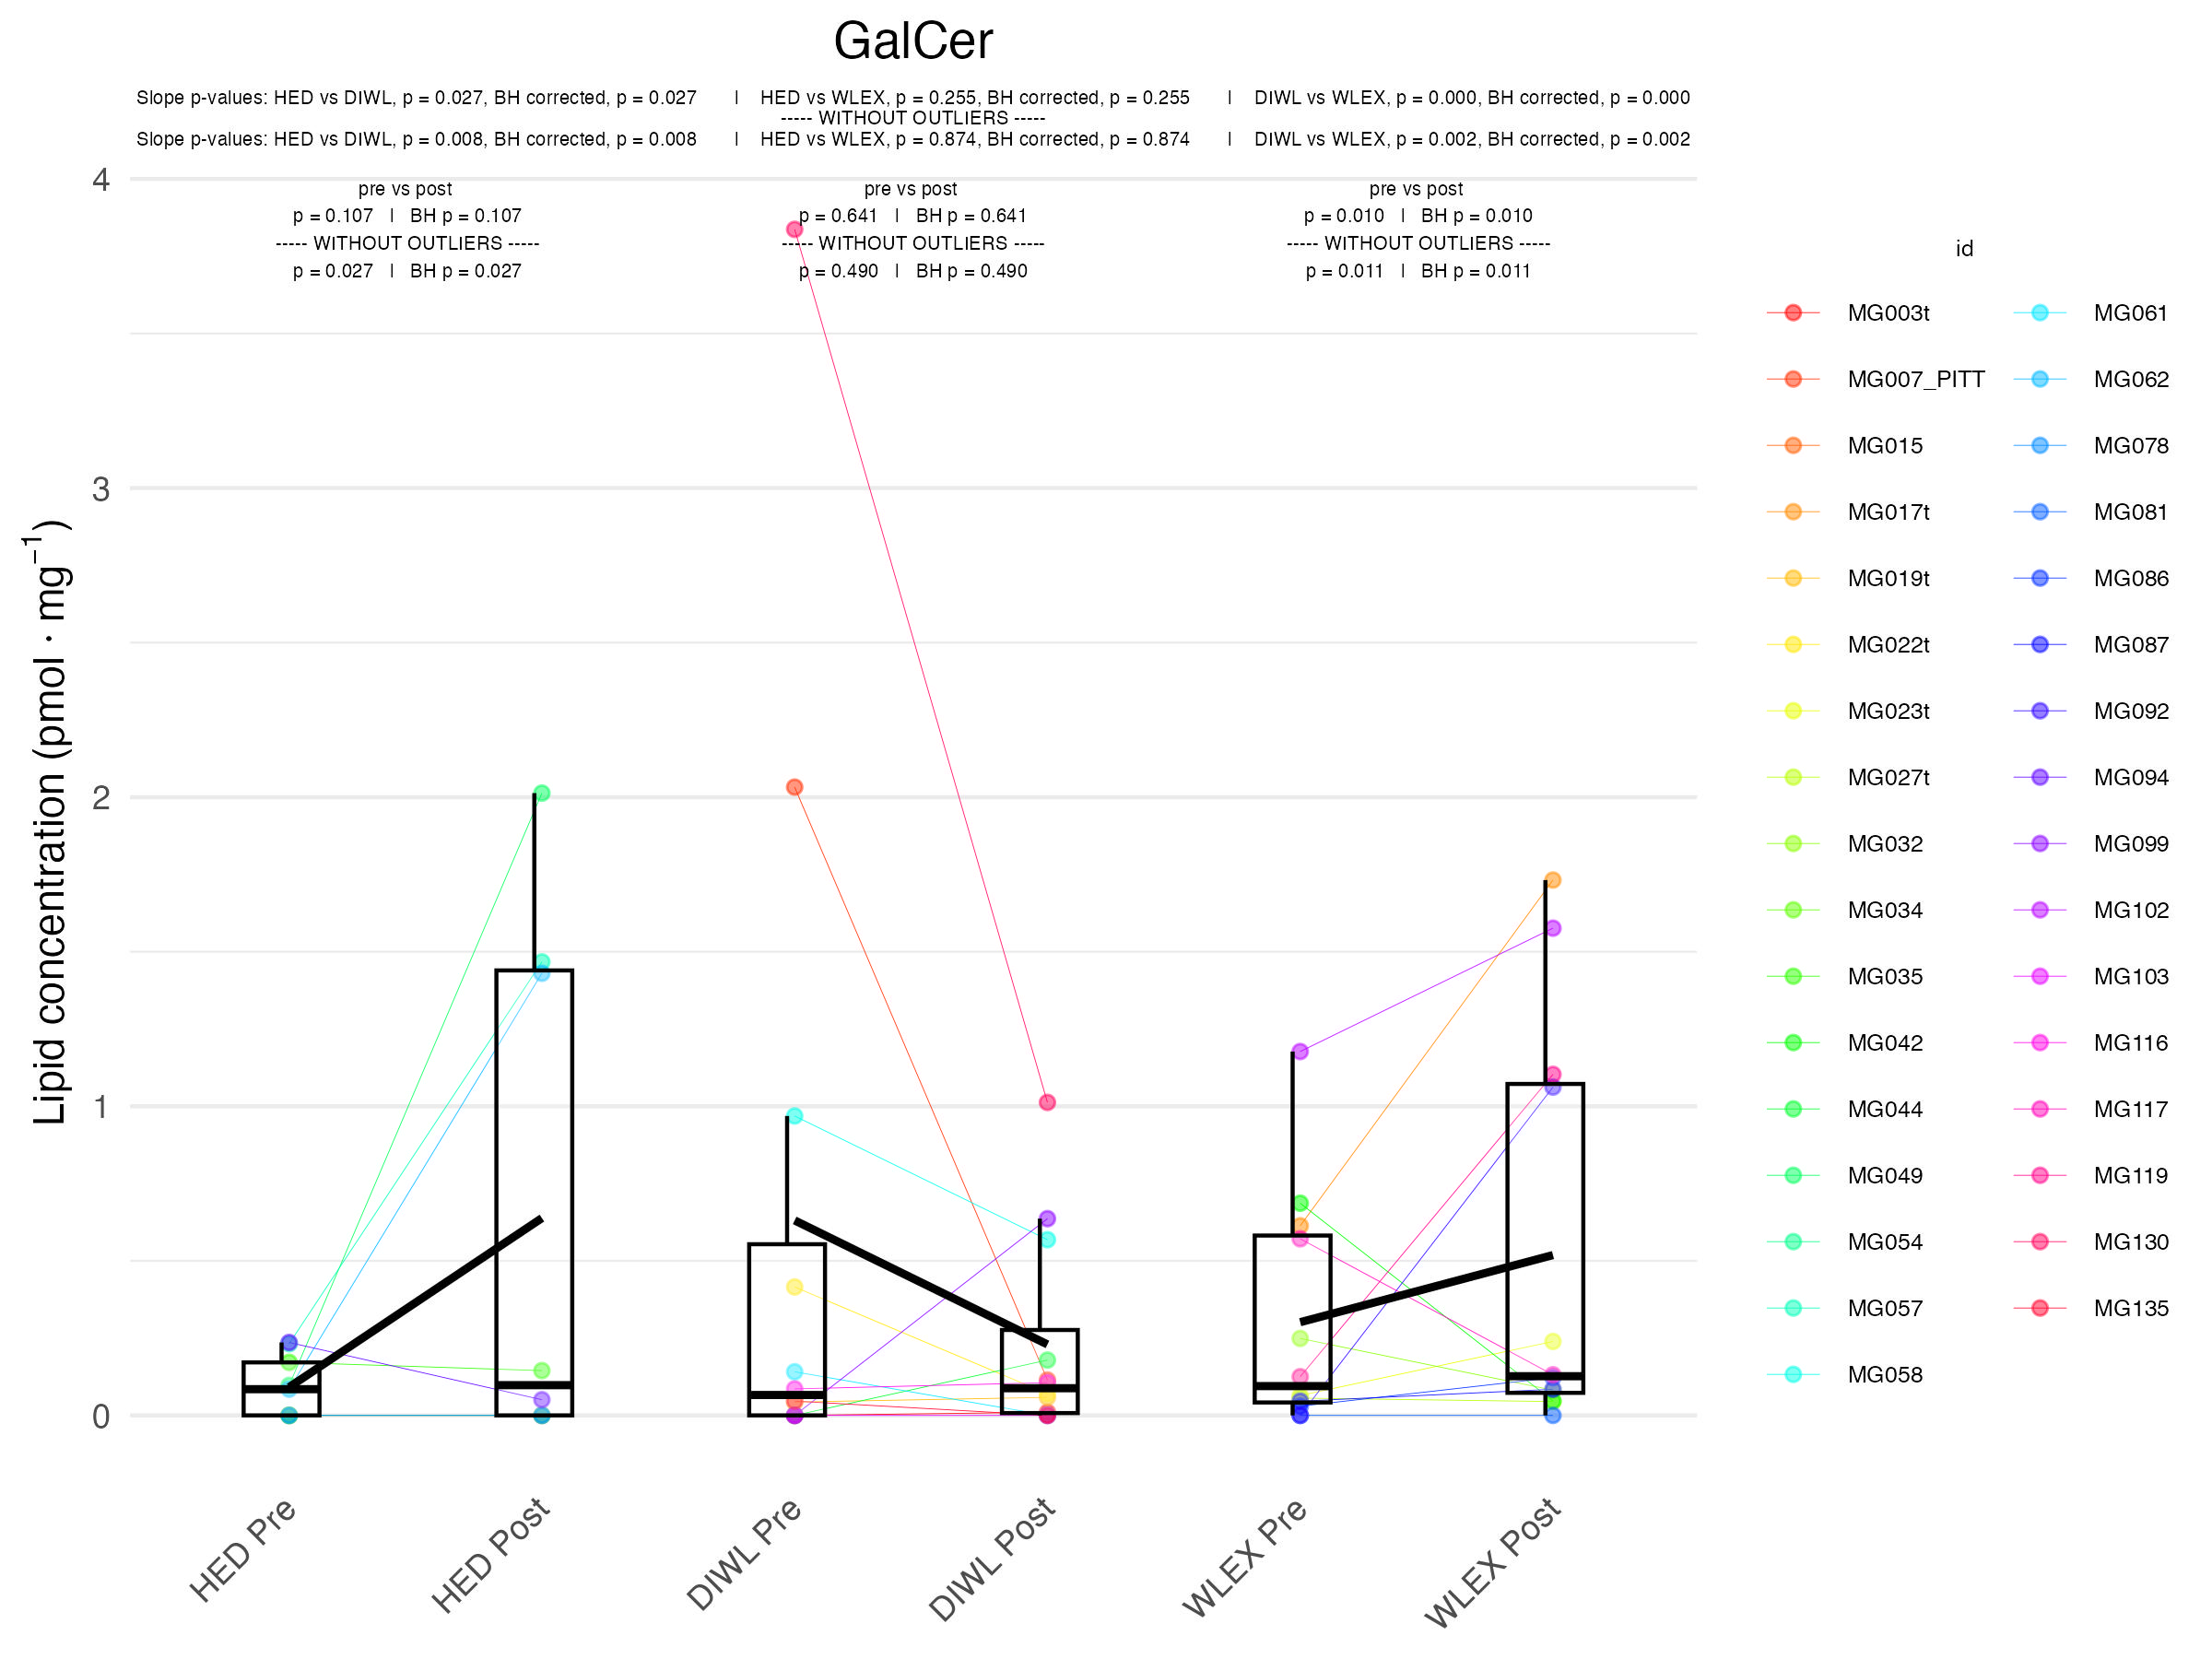
t-test: ~0.06
mixed model: ~ 0.001

